Slide 1

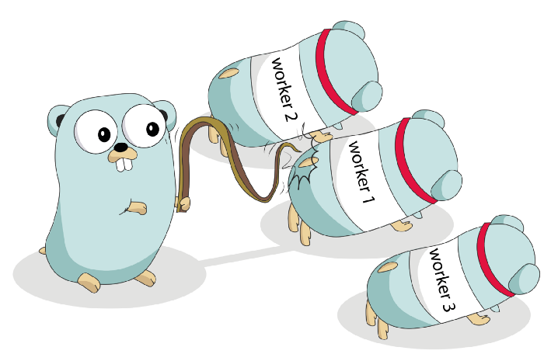
Go Packages and Concurrency Quiz
https://bit.ly/3kkeGwL

